Slide 1
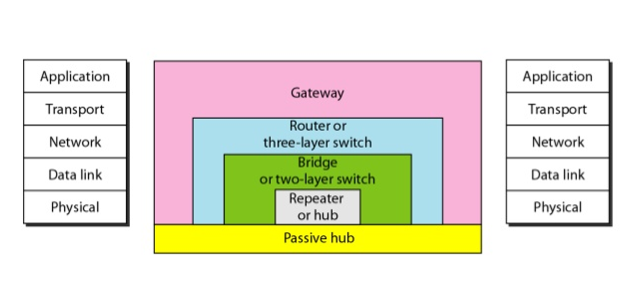
CONNECTING DEVICES
17 JULY 2026

Slide 2
The Five Categories of Connecting Devices Can Be Defined As
Those which operate below the physical layer such as a passive hub.
Those which operate at the physical layer (a repeater or an active hub).
Those which operate at the physical and data link layers (a bridge or a two-layer switch).
Those which operate at the physical, data link, and network layers (a router or a three-layer switch).
Those which can operate at all five layers (a gateway).

Slide 3
Passive Hubs
A passive hub is just a connector. It connects the wires coming from different branches.
In a star-topology Ethernet LAN, a passive hub is just a point where the signals coming from different stations collide; the hub is the collision point. This type of hub is part of the media;
Its location in the Internet model is below the physical layer.

Slide 4
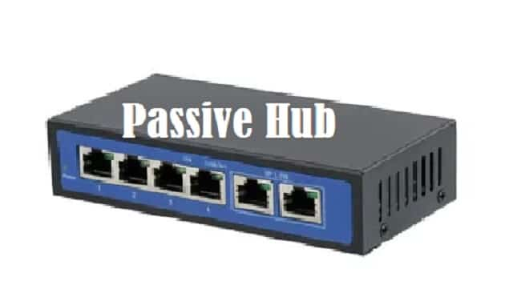

Slide 5
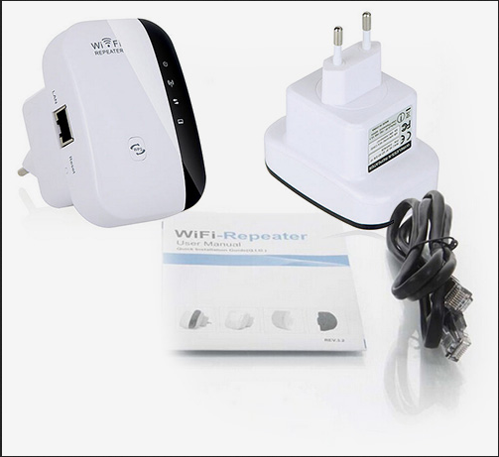
Repeaters

Slide 6
Repeaters
A repeater is a device that operates only in the physical layer.
A repeater receives a signal, before it becomes too weak or corrupted, and regenerates the original bit pattern. The repeater then sends the refreshed signal.
Does not actually connect two LANs. It connects two segments of the same LAN.
The segments connected are still part of one single LAN.

Slide 7
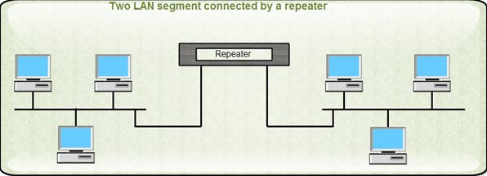
Repeaters

Slide 8
Repeater
Acts as a two-port node, but operates only in the physical layer. When it receives a frame from any port, it regenerates it and forwards it to the other port.
Forwards every frame; it has no filtering capability.
Does not amplify the signal; it regenerates the signal. When it receives a weakened or corrupted signal, it creates a copy, bit for bit, at the original strength.
The location of a repeater on a link is vital. A repeater must be placed so that a signal reaches it before any noise changes the meaning of any of its bits.

Slide 9
Bridge
Operates in both physical & data link layers
It connects two different LANs
As a physical layer device, it regenerates the signal it receives. As a data link layer device, the bridge can check the physical (MAC) addresses (source and destination) contained in the frame.
A bridge has filtering capability. It can check the destination address of a frame & decide if the frame should be forwarded or dropped. If the frame is to be forwarded, the decision must specify the port. A bridge has a table that maps addresses to ports.
Note: A bridge does not change the physical addresses contained in the frame.

Slide 10
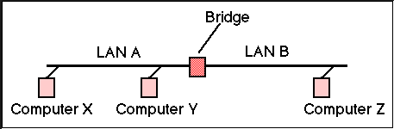
Bridge
Notes:
The bridge forwards data only to the correct LAN by checking the destination MAC address, reducing unnecessary network traffic.
Example from the figure:
If Computer X sends data to Computer Y (both on LAN A), the bridge does not forward the data to LAN B.
If Computer X sends data to Computer Z (on LAN B), the bridge forwards the data to LAN B.

Slide 11
Issues to be considered while connecting different LAN
Frame format: Each LAN type has its own frame format (compare an Ethernet frame with a wireless LAN frame).
Maximum data size: If an incoming frame's size is too large for the destination LAN, the data must be fragmented into several frames. The data then needs to be reassembled at the destination.

Slide 12
Issues to be considered while connecting different LAN
Data rate: Each LAN type has its own data rate. (Compare the 10-Mbps data rate of an Ethernet with the 1-Mbps data rate of a wireless LAN.) The bridge must buffer the frame to compensate for this difference.
Bit order: Each LAN type has its own strategy in the sending of bits. Some send the most significant bit in a byte first; others send the least significant bit first.
Notes:
A buffer is simply a temporary storage area.

Slide 13
See you Tuesday

Slide 14
Issues to be considered while connecting different LAN
Security: Some LANs, such as wireless LANs, implement security measures in the data link layer. Other LANs, such as Ethernet, do not. Security often involves encryption When a bridge receives a frame from a wireless LAN, it needs to decrypt the message before forwarding it to an Ethernet LAN
Multimedia support: Some LANs support multimedia and the quality of services needed for this type of communication; others do not

Slide 15
Two-Layer Switches
A network device that operates at the data link layer (2)
Responsible for forwarding data frames between devices on the same LAN.
Unlike hubs, which broadcast data to every connected device
Layer 2 switches intelligently forward data only to the device it is intended for, using MAC addresses.

Slide 16
Key difference
Hubs operate via data broadcasting, sending data to all connected devices regardless of the intended recipient.
Layer 2 switches, use MAC address tables to send data directly to the right device, reducing network congestion.
Layer 3 switches – while 2 focuses on MAC addresses, layer 3 switches operate at the network layer, forwarding data based on IP addresses.
Notes:
- This enables Layer 3 switches to route traffic between different networks, a capability not available in Layer 2 switches.

Slide 17
Role in networks
Improved data flow – forwarding traffic only to the intended recipient.
Collision reduction – each port on layer 2 switch functions as its own collision domain, reducing data collisions within the network.
Traffic management – efficiently manages data flow & bandwidth allocation across devices, ensuring seamless user experience.

Slide 18
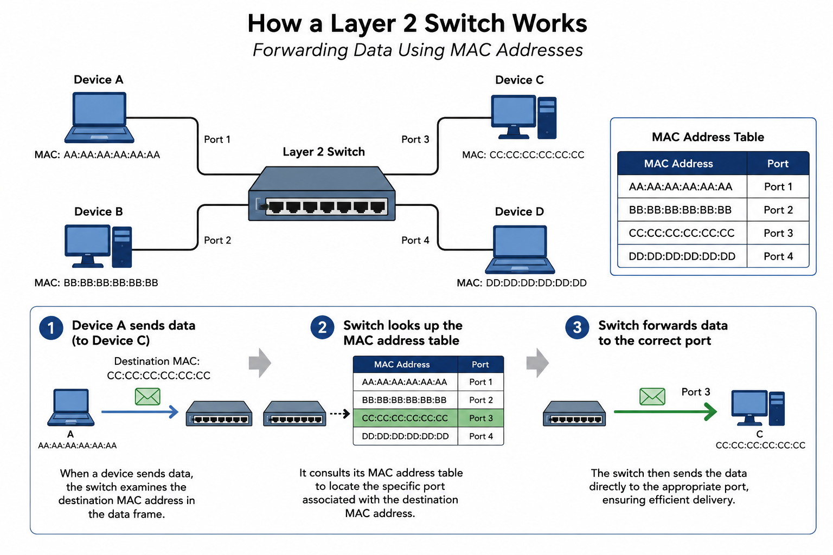

Slide 19
Building & Maintaining MAC Add Table
Layer 2 switch dynamically learns & updates MAC address tables through the Address learning
When a device communicates with the network, the switch records the MAC address of the sender & associates it with the respective port.
Table is updated continuously to adapt to changes in network topology

Slide 20
Collision reduction
Switches divide a LAN into multiple collision domains, effectively isolating traffic between devices & preventing data collisions.
This segmentation improves overall network performance & reliability

Slide 21
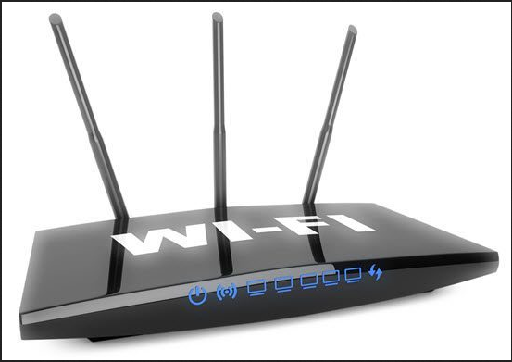
Routers

Slide 22
Routers
A router is a three-layer device that routes packets based on their logical addresses (host-to-host addressing).
Router normally connects LANs and WANs in the Internet and has a routing table that is used for making decisions about the route.
The routing tables are normally dynamic and are updated using routing protocols.

Slide 23
Router
Routers use headers and forwarding tables to determine the best path for forwarding the packets, and they use protocols such as ICMP to communicate with each other and configure the best route between any two hosts
The primary function of a router is to connect networks together and keep certain kinds of broadcast traffic under control

Slide 24
Three-layer Switch
A three-layer switch is a router, but a faster and more sophisticated. The switching fabric in a three-layer switch allows faster table lookup and forwarding.
Device that combines the functions of a layer 2 switch with the routing capabilities of a layer 3 router

Slide 25
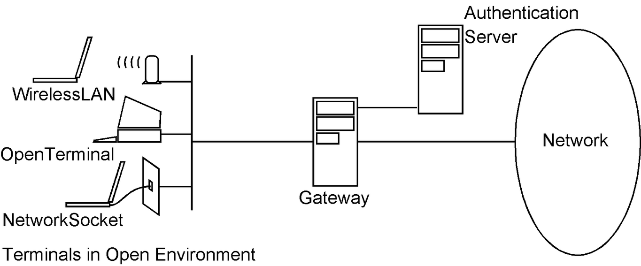
Gateway

Slide 26
Gateway
A gateway is normally a computer that operates in all five layers of the Internet or seven layers of OSI model.
A gateway takes an application message, reads it, and interprets it.
connecting device between two internetworks that use different models.
For example, a network designed to use the OSI model can be connected to another network using the Internet model.

Slide 27
Gateway
routes traffic from a workstation to the outside network that is serving the Web pages.
In homes, the gateway is the ISP that connects the user to the internet.
In enterprises, the gateway node often acts as a proxy server and a firewall.
The gateway is also associated with both a router, which use headers and forwarding tables to determine where packets are sent, and a switch, which provides the actual path for the packet in and out of the gateway

Slide 28


